Slide 2
Presenter
Patrick Cuba, Principal Consultant, Cuba BI Consulting
Patrick is a SAS solution specialist at Cuba BI Consulting in Sydney, Australia since 2011.
Patrick architects solutions using SAS software from design right through to implementation. He has worked on SAS Customer Intelligence, SAS Anti Money Laundry, SAS Credit Risk, SAS DDS for Banking, SAS SPDS and SAS Visual Analytics at various client types such as Banking, Insurance and Marketing.
He has worked with SAS software for more than 14 years.

Slide 3
My SAS® Grid Scheduler
Using SAS DI Studio & Grid to run SAS Enterprise Guide code

Slide 4
Agenda
Why make our own scheduler?
My SAS Grid Scheduler
Back to basics
Parts we need
Putting it all together
Conclusion
Questions

Slide 5
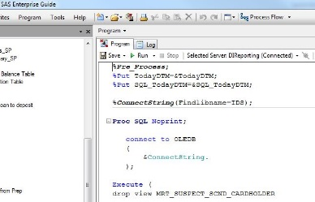
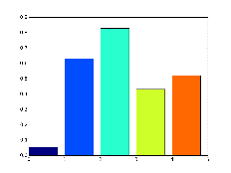

Why make our own scheduler?
Schedule without upskilling in scheduling software
Avoid executing canned reports manually over and over
Use SAS products we may be already licensed for
Make rapid changes to SAS code without having to deploy SAS programs to production server
Help business users:
Run SAS code as soon as data is available
Notes:
I have enjoyed a relatively long career in SAS solution consulting and one of the benefits of consulting is getting to learn how different industries work, how businesses are run and how technology frees up more time for the end users. With more and more exciting ways to explore data and write reports, new regulatory requirements and being able to get creative with ways to engage the customer through Customer Analytics; the demands on the end user to keep up to speed with their own specialties whether it be Basel 3 or the upcoming Basel 4, Solvency 2, General Data Protection Regulation (GDPR), Payment Service Directive (PSD2), Anti-Money Laundering, Terrorism and Fraud Scenarios; the last thing on the end user’s mind is scheduling technology.
A fairly recent client engagement for me was actuaries and I discovered how much of their day is spent on working on pricing, modelling and running reports. To have their data ready by Monday morning they would run their Mart builds over the weekend by way of running SAS programs through a Windows Scheduler and having all their modules listed as %includes in a Master SAS program. Should one of the modules fail they would have to trawl through their logs to find where it did fail and rerun their schedule from the failing module onwards. They’re code needed to respond to insurance events like the fire in Adelaide or flooding in Sydney which likely meant on-the-fly SAS program edits. A large portion of their results were exported to Excel spreadsheets.
Keeping their programs up to date hardly afforded them time to learn new software let alone the inner workings of scheduling and what scheduler provides what features they might want or not want to use!

Slide 6
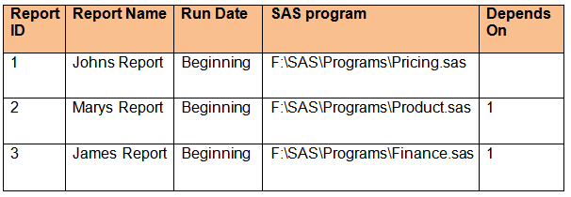
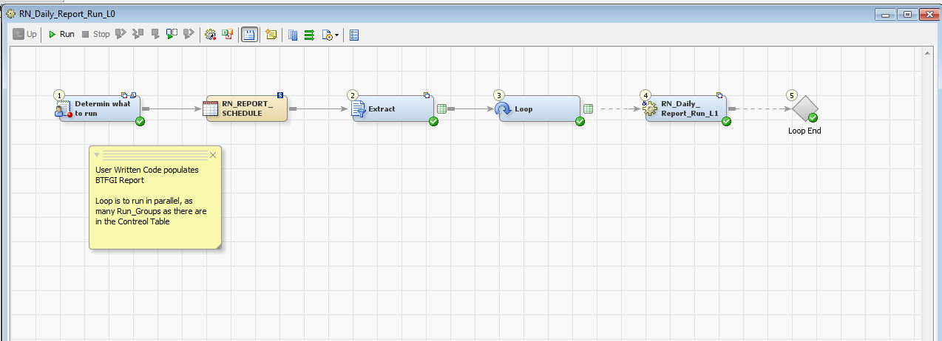
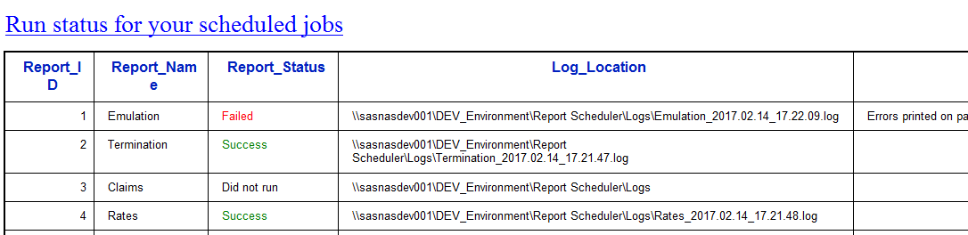
My SAS Scheduler
Overview
Register programs you want to run
#
SAS DI Studio runs the programs on GRID
Send notifications on report completion status
Notes:
The solution I proposed has an interface they are familiar with (Excel), uses technology they are licensed for (GRID) and maintains familiarity in the sense that they are still working with their own SAS code and logs.
Excel is used to register the reports they want to run. Like %include in Base SAS the user simply copies the filename and path of the SAS program they want to run into the spreadsheet. We read that into SAS once and only update that dataset when there are changes to what we want to run.
SAS Grid for optimizing their workload and SAS DI Studio for making effective use of Grid.

Slide 7

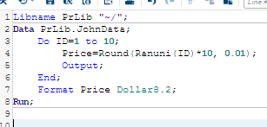
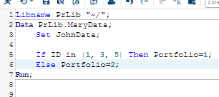
Back to basics
What is Job Scheduling?
“A job scheduler is a computer application for controlling unattended background program execution of jobs”
“…a job is a unit of work or unit of execution…”
Main Concepts
Job 1
Depends on
Job 2
Jobs
Dependencies
Notes:
Let’s go back to basics
What is a job scheduler? What is a job?
Job scheduling makes use of server downtime when people are not running their SAS code. This can be overnight, over the weekend, once a quarter and in some cases during the day.
A Job in our context are the SAS programs and reports we wish to run. They are tasks assigned to the server.
2) What are dependencies?
For effective scheduling we need to run jobs when appropriate, when certain data is updated and available and as soon as they are available.

Slide 8


Back to basics
What is Job Scheduling?
Run related jobs together
Frequency can be quarterly, monthly, daily, weekly
and may need to wait for external files
Notify users
Main Concepts
Stream 1
Job Streams
Job 1
Job 2
Time Triggers
Event Triggers
Notifications
Stream 2
Event
Job 3
Job 4
Notes:
We run our related jobs together and should not need to wait for unrelated jobs to run before we need to run our own jobs.
In scheduling we want to be able to set when the reports should run. A particular day in the week, monthly, quarterly, a few times in the week, 3rd day of the month.
We should only run the report when certain files are available outside of the schedule and lastly we like to know as soon as the reports become available.

Slide 9

Parts we need
1. Interface – (Tell the scheduler what to do)
Register
What SAS programs to run – Jobs
When to run – Time & Event Triggers
In what order? – Dependencies
Who to notify? – Emails
Report ID | Report Name | Run Date | SAS program | Depends On | Email Notification | File Trigger
1 | Johns Report | Monday | F:\SAS\Programs\Pricing.sas |  | john@mycompany.com
2 | Marys Report | Beginning | F:\SAS\Programs\Product.sas | 1 | mary@mycompany.com
3 | James Report | Quarterly | F:\SAS\Programs\Finance.sas | 1 | john@mycompany.com james@mycompany.com | F:\SAS\Logs\GL_&sydate9.
Control
Table
Notes:
Let’s talk about the parts we need
- We need to register what SAS programs to run – tell the scheduler what to do.
- When to run the SAS programs
- Do the SAS programs need to wait for anything
- Who needs to be notified of the completion status of the report
All components are registered in an excel spreadsheet and read into a SAS dataset once and only once.
We validate that the paths and files registered in the spreadsheet exist.

Slide 10



Parts we need
2. SAS Grid - (Loadbalancing and parallelism)
“Grid provides workload management to optimally process multiple applications and workloads to maximize overall throughput”
Grid Node 1
Grid Node 3
“The grid enables SAS job subtasks to run in parallel on different parts of the grid, which completes the job much faster”
Grid Controller
Grid Client
Grid Node 2
Grid Node n
DI Studio
Notes:
It is not in scope for this paper to go into detail of Grid however in order highlight its importance to this paper we will show basic topology of SAS Grid.
Grid enables:
Workload Balancing
Job prioritization
High availability
Parallel processing
Resource assignment and monitoring
A typical installation will have
a Grid controller Node responsible for distributing work amongst the Worker nodes and;
one to many Worker nodes
Client interfaces for using Grid, like Enterprise Guide, Data Integration Studio and Enterprise Miner
Platform RTM for SAS to monitor and manage the Grid environment

Slide 11




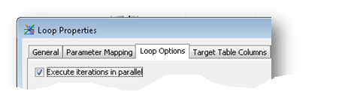
Parts we need
3. SAS DI Studio - (Code looping and parameter parsing)
Iteration in DI Studio
3 table entries
parse sas program
Control Table
3 loops
subjob
Allow Grid to run the subjobs in parallel
Notes:
We make use of SAS DI Studio to generate Base SAS code to use Grid
We take the SAS report program entries we have registered in a Control Table and use that as an input into a SAS DI Studio job
We use the Loop & Loop End transformations available in SAS DI Studio that will generate SAS Grid/Connect code for us
We place a subjob between the Loop & Loop End transformations
We add parameters to the subjob
We map the columns we need from the Control table to parameters in the subjob thereby parsing the column values to the subjob one record at a time
We instruct DI Studio to run the subjob in parallel or sequentially
In our example we have three entries in “Johns Report”, “Marys Report” and “James Report”. Each record will be parsed to the subjob through the Loop transformation and run in parallel.

Slide 12
Parts we need
4. SAS batch command - (Execute the Report Code)
Run SAS code in BATCH mode
E:\SAS\Config\Lev1\BatchServer\sasbatch.bat
-sysin F:\SAS\Programs\Pricing.sas
-log F:\SAS\Logs\Pricing_#Y#m#d-#H#M#s.log
-batch –logparm “rollover=session” -noterminal
-noxcmd
Notes:
SAS Batch programs are run by a batch command and for the purpose of running the user’s code we need that command line to run SAS programs.
We will use sasbatch.bat for ????
-sysin specifies a batch mode source file
-log is the location of where to store the SAS program’s logs
-batch to specify batch mode
-logparm to control logging behavior, a log is generated for each session
-noterminal tells SAS not to check for a terminal device
-noxmcd to prevent users from running OS level commands. This is often cited as a security risk

Slide 13

Putting it all together
Running the Reports
Not all Reports should run at the same time
Report ID | Report Name | SAS program | Log
1 | Johns Report | F:\SAS\Programs\Pricing.sas | F:\SAS\Logs\Pricing
2 | Marys Report | F:\SAS\Programs\Product.sas | F:\SAS\Logs\Product
3 | James Report | F:\SAS\Programs\Finance.sas | F:\SAS\Logs\Finance
How we tell SAS DI Studio the order on which to run the Reports?
Notes:
Now that we have all the parts we need lets explain by way of an example
We have three reports registered to run from the control table.
Each registered report has a SAS program registered and a location to save our logs
We have given each report a unique ID
Here we have not specified any dependencies so we assume that the reports are independent and they can be run in parallel.
If we were to imagine that these reports are run sequentially then the total run time would be 60 minutes.
If they were all to run in parallel their total run time will be length of the longest running job, “Job 2” at 30 minutes
BUT, Mary and James needs data from Johns report before they can run their report. So how do we tell SAS DI Studio the order needed to run the reports?

Slide 14
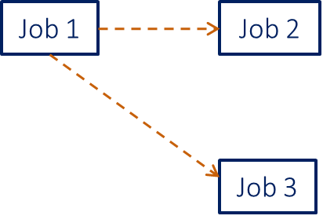
Putting it all together
Calculate Run Order
2 distinct run orders
Run Order
Report ID | Report Name | SAS program | Log | Depends On
1 | Johns Report | F:\SAS\Programs\Pricing.sas | F:\SAS\Logs\Pricing
2 | Marys Report | F:\SAS\Programs\Product.sas | F:\SAS\Logs\Product | 1
3 | James Report | F:\SAS\Programs\Finance.sas | F:\SAS\Logs\Finance | 1
1
2
same run order , no dependency, run in parallel
Report ID | Report Name | SAS program | Log | Run Order
1 | Johns Report | F:\SAS\Programs\Pricing.sas | F:\SAS\Logs\Pricing | 1
2 | Marys Report | F:\SAS\Programs\Product.sas | F:\SAS\Logs\Product | 2
3 | James Report | F:\SAS\Programs\Finance.sas | F:\SAS\Logs\Finance | 2
Notes:
We add a Dependency column based on the Report ID
Here we have stated that Mary’s and James’ Reports are dependent on John’s Report
The “Depends On” column determines the “Run Order”
“Johns Report” will run 1st and “Marys Report” and “James Report” will run at the same time and AFTER “Johns Report” – we have 2 distinct Run Orders: 1 and 2.

Slide 15
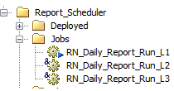
Putting it all together
Run Order selection in DI Studio
Select One Run Order at a time starting from 1
Same Run Order
L1
No parallelism; parse Run Order
Select Distinct Run Order Asc
L2
In parallel
Report ID | Report Name | Run Order
1 | Johns Report | 1
2 | Marys Report | 2
3 | James Report | 2
Select entry Where Run Order = Parsed Run Order
Notes:
We have three levels of SAS DI Jobs, L1 to L3
L1 is the main SAS DI Studio job that will run L2 as a subjob
L2 in turn will run L3 as a subjob
L1 will select the DISTINCT Run Orders to run will run them sequentially.
This will be done in Ascending Order by Run Order to ensure that all reports with Run Order=1 are run before we run reports with a Run Order=2.
L2 in turn will then run everything with the same Run Order in parallel as the Reports with the same Run Order are independent.
Once “Johns Report” has completed both “Marys Report” and “James Report” will be executed.

Slide 16
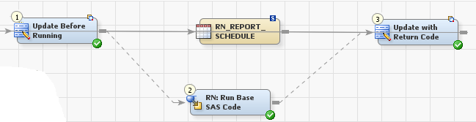

Putting it all together
Executing SAS code as batch
The batch command we seconded is used to run the Report Code
L2
Parse the program
L3
Set to Running
Set to Complete
Parsed program name
SAS Batch command parsed from batch autoexec
SAS Batch command
Notes:
L2 will run L3 and parse all the execution details needed to run the SAS program
L3 is responsible for running the SAS Batch command and updates the Control table with a completions status, run times and where the log filenames stored

Slide 17
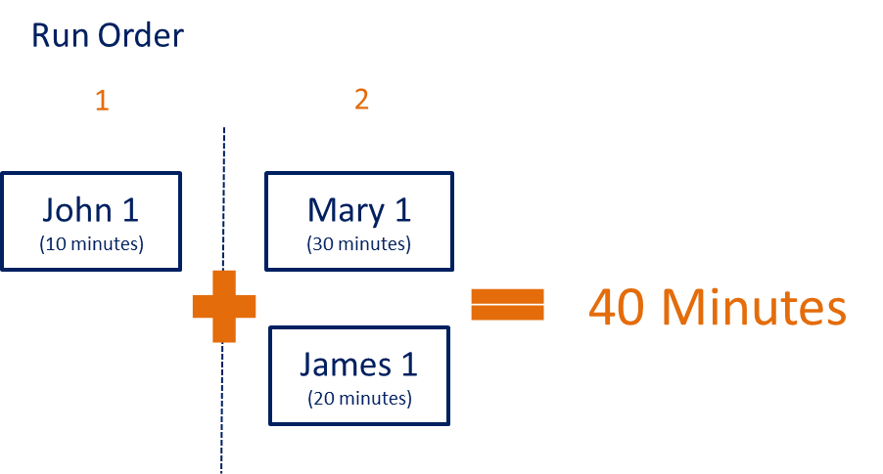
Putting it all together
Running the Reports
Johns Report must run first, but Mary and James can run at the same time
Report ID | Report Name | SAS program | Log | Depends On
1 | Johns Report | F:\SAS\Programs\Pricing.sas | F:\SAS\Logs\Pricing
2 | Marys Report | F:\SAS\Programs\Product.sas | F:\SAS\Logs\Product | 1
3 | James Report | F:\SAS\Programs\Finance.sas | F:\SAS\Logs\Finance | 1
Here we have established parallelism
Notes:
“John 1” completed in 10 minutes and after those 10 minutes “Mary 1” and “James 1” executed.
“Mary 1” took 30 minutes and “James 1” took 20 minutes so the complete run time for the schedule is 40 minutes as the total run time is the sum of the longest running jobs at each Run Order.
There is a flaw in this design….

Slide 18
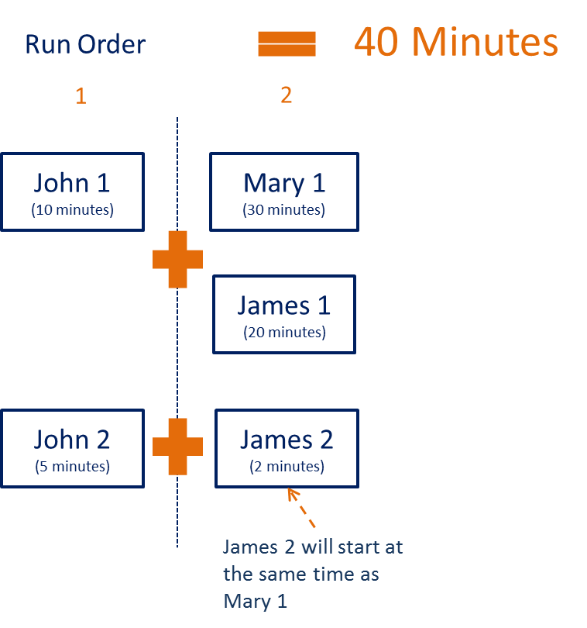
Putting it all together
The indirect dependency problem
Unrelated Reports
Report ID | Report Name | SAS program | Log | Depends On
1 | Johns Report | F:\SAS\Programs\Pricing.sas | F:\SAS\Logs\Pricing
2 | Marys Report | F:\SAS\Programs\Product.sas | F:\SAS\Logs\Product | 1
3 | James Report | F:\SAS\Programs\Finance.sas | F:\SAS\Logs\Finance | 1
4 | Johns Report 2 | F:\SAS\Programs\Pricing_2.sas | F:\SAS\Logs\Pricing
5 | James Report 2 | F:\SAS\Programs\Finance_2.sas | F:\SAS\Logs\Finance | 4
Using our established logic; there is a problem
James 2 will only start after John 1 has completed
Notes:
This is the indirect dependency problem.
John has a new report “Johns Report 2” but it is totally independent from all other reports and therefore no dependency is set. It will run at the same time as his other report “John Report 1”.
James would like to run a new report from the data produced from John’s second report. He will make is dependent on this new report alone and call it “James Report 2”. It has no other dependency except “Johns Report 2”
But as we have seen SAS DI Studio by this design will only begin executing the next “Run Order” once the first “Run Order” has completed. Therefore “James 2” can only execute after “John 1” and “John 2” has completed. Therefore the entire schedule will still take 40 minutes!
How do we resolve this?

Slide 19
Putting it all together
Calculate Job Streams
run related reports independently
Run Order
Report ID | Report Name | SAS program | Log | Depends On
1 | Johns Report | F:\SAS\Programs\Pricing.sas | F:\SAS\Logs\Pricing
2 | Marys Report | F:\SAS\Programs\Product.sas | F:\SAS\Logs\Product | 1
3 | James Report | F:\SAS\Programs\Finance.sas | F:\SAS\Logs\Finance | 1
4 | Johns Report 2 | F:\SAS\Programs\Pricing_2.sas | F:\SAS\Logs\Pricing
5 | James Report 2 | F:\SAS\Programs\Finance_2.sas | F:\SAS\Logs\Finance | 4
1
2
2
split by job streams
Job Streams
Report ID | Report Name | SAS program | Log | Run Order | Job Stream
1 | Johns Report | F:\SAS\Programs\Pricing.sas | F:\SAS\Logs\Pricing | 1 | 1
2 | Marys Report | F:\SAS\Programs\Product.sas | F:\SAS\Logs\Product | 2 | 1
3 | James Report | F:\SAS\Programs\Finance.sas | F:\SAS\Logs\Finance | 2 | 1
4 | Johns Report 2 | F:\SAS\Programs\Pricing_2.sas | F:\SAS\Logs\Pricing | 1 | 2
5 | James Report 2 | F:\SAS\Programs\Finance_2.sas | F:\SAS\Logs\Finance | 2 | 2
1
Job 4
Job 5
Notes:
We split the Jobs into Job Streams….
We do this assigning a unique value on-the-fly to split what Reports can run together
All Reports assigned the same Job Stream will run together
“Johns Report”, “Marys Report” and “James Report” will run together and “Johns Report 2” and “James Report 2” will run together.
How does this translate into SAS DI Studio?

Slide 20
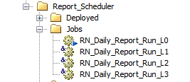
Putting it all together
Job Stream selection in DI Studio
All Job Streams start at the same time
L0
in parallel; parse the Job Stream
Select Distinct Job Streams
L1
Report ID | Report Name | Run Order | Job Stream
1 | Johns Report | 1 | 1
2 | Marys Report | 2 | 1
3 | James Report | 2 | 1
4 | Johns Report 2 | 1 | 2
5 | James Report 2 | 2 | 2
L2
Notes:
In SAS DI Studio we make L1 a subjob of a new level L0.
L0 will select the distinct Job Streams to run (2) and run them in parallel.

Slide 21

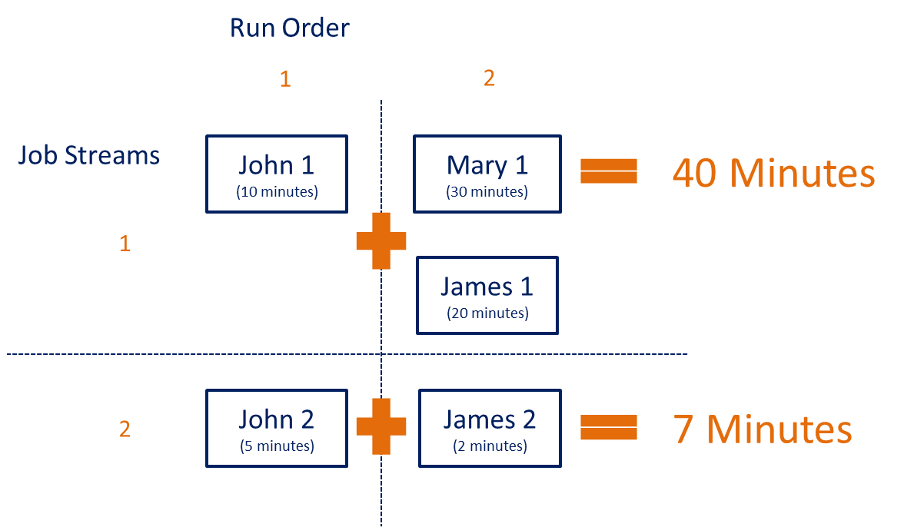
Putting it all together
Running the Reports
Reports are now run as efficiently as possible
Report ID | Report Name | SAS program | Log | Depends On
1 | Johns Report | F:\SAS\Programs\Pricing.sas | F:\SAS\Logs\Pricing
2 | Marys Report | F:\SAS\Programs\Product.sas | F:\SAS\Logs\Product | 1
3 | James Report | F:\SAS\Programs\Finance.sas | F:\SAS\Logs\Finance | 1
4 | Johns Report 2 | F:\SAS\Programs\Pricing_2.sas | F:\SAS\Logs\Pricing
5 | James Report 2 | F:\SAS\Programs\Finance_2.sas | F:\SAS\Logs\Finance | 4
‘James 2’ will start as soon as John 2 completes
Notes:
At this point we have reached optimal scheduling efficiency.
“John 1”, “Mary 1” and “James 1” will still take 40 minutes to complete this job stream but “John 2” and “James 2” will now take only 7 minutes to complete

Slide 22
Putting it all together
Setting a Date
The DI Job runs everyday; but the control table says if the reports should run today
Report ID | Report Name | Run Date | SAS program | Log | Depends On
1 | Johns Report | Beginning | F:\SAS\Programs\Pricing.sas | F:\SAS\Logs\Pricing
2 | Marys Report | Beginning | F:\SAS\Programs\Product.sas | F:\SAS\Logs\Product | 1
3 | James Report | Beginning | F:\SAS\Programs\Finance.sas | F:\SAS\Logs\Finance | 1
2016/12/02 ---------- RUN ONCE
Monday ---------- Every Monday
Daily ---------- Every Day
Beginning ---------- Start of the month, Beginning:3 ---------- 3rd Day of Month
Quarterly ---------- Every Quarter
Notes:
Now for the remaining components.
L0 (that runs all the subjobs) will run daily and check the control table for the report’s Run Date
If Today() = Run Date then that Report will be scheduled to run today.
The values we can set in this column are:
Date to run once
Monday to run every Monday
Daily to run everyday
Beginning to run in the beginning of the month. You can add a colon (:) and a numeric value to denote a day of the month to run. ??? 43
End to denote the end of the month
Quarterly to denote quarterly reports
If a dependent job is scheduled on a different day, should it still run?
We have also included a flag to denote if a report can be run on non-workdays. For example if the date set falls on a Saturday then the report will be delayed to next available run date, Monday.
A Public Holiday table is used as input to add to the dates the Reports will not run but instead delayed to the next available run date.
We can also set the flag to not allow the report to run on a weekend or public holiday at all

Slide 23
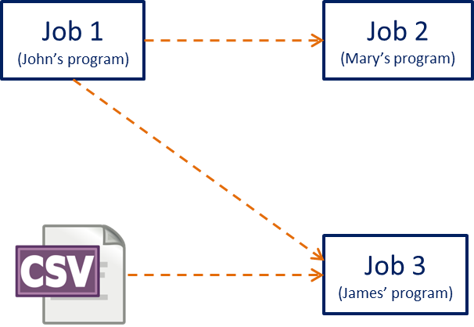
Putting it all together
Waiting for an event
We can force the Report to wait for a file event
Report ID | Report Name | Run Date | SAS program | Log | Depends On | File Trigger
1 | Johns Report | Beginning | F:\SAS\Programs\Pricing.sas | F:\SAS\Logs\Pricing
2 | Marys Report | Beginning | F:\SAS\Programs\Product.sas | F:\SAS\Logs\Product | 1
3 | James Report | Beginning | F:\SAS\Programs\Finance.sas | F:\SAS\Logs\Finance | 1 | F:\SAS\Logs\GL_&sydate9
Scheduler will continue to poll for the file event until it arrives
Notes:
We can also have a file event for a report to wait for. In case the report needs to wait for the appearance of a CSV file the report will poll for the file/event trigger very five minutes until the trigger arrives.
What if the event trigger never arrives?
We have added a column for users to register a value in seconds in order to wait for a file event. Once the timeout period has been reached the report is set to “Did Not Run” in the control table. If no timeout is set then we set the timeout value to a default value of 23 hours.
If the data file you are waiting for is registered as the trigger then there is a danger that this will fail the process. Why?
The SAS program used to poll for the file event will instruct SAS DI Studio to begin execution of the report as soon as the FILENAME is noticed meaning that if it is a data file the upload to that location may have not yet completed by the time the SAS program runs and either the report program will fail due to restricted access of locked file or the data loaded into the report will become corrupt. The former is better as undetected errors are far more dangerous then detected ones.
A solution around this is to either have a separate event trigger file to denote the COMPLETION of the external file upload or upload to the registered file location under a different name than the filename registered in the control table. The upload process should then rename the external file to the expected filename upon completion.
Consider using a macro variable to denote a new filename suffix if the report is run more than once or have your own process to either move or delete the filename once the report has completed a successful run.

Slide 24
Putting it all together
Notifications
an email is sent to the users who have registered their email addresses
Report ID | Report Name | Run Date | SAS program | Log | Depends On | Email Notification | File Trigger
1 | Johns Report | Beginning | F:\SAS\Programs\Pricing.sas | F:\SAS\Logs\Pricing |  | john@mycompany.com
2 | Marys Report | Beginning | F:\SAS\Programs\Product.sas | F:\SAS\Logs\Product | 1 | mary@mycompany.com
3 | James Report | Beginning | F:\SAS\Programs\Finance.sas | F:\SAS\Logs\Finance | 1 | john@mycompany.com james@mycompany.com | F:\SAS\Logs\GL_&sydate9
Report Status
Success
Ended with warnings
Failed
Did not run
Notes:
Finally we register an email address to send the completion status to.
An email with completion status of:
“Success” – SAS program completed with no Errors or Warnings
“Ended with warnings” – SAS program completed but had warnings registered in the log
“Failed” – the SAS program ended with errors and aborted. Any dependent SAS program will not run
“Did not run” – the SAS program did not run because either an event trigger did not arrive or a SAS program this SAS program is dependent on failed or did not run

Slide 25

Conclusion
Have we fulfilled the main concepts?
Main Concepts
Jobs
Dependencies
Job Streams
Stream 1
Time Triggers
Job 1
Depends on
Job 2
Event Triggers
Notifications
Stream 2
Event
Job 3
Depends on
Job 4
Notes:
In conclusion we go back to what we considered were the main concepts needed to build an efficient scheduler.
Did we fulfill them?

Slide 26
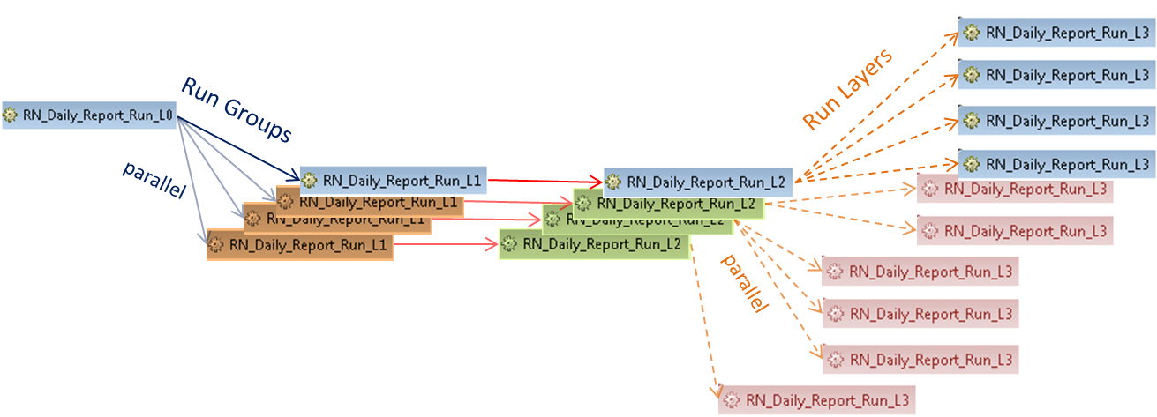
Questions?
Have we fulfilled the main concepts?

Slide 27
Contact Information
Patrick Cuba
Principal Consultant
Cuba BI Consulting, Sydney, Australia
+61 458 912 634
patrickcuba8@gmail.com
https://au.linkedin.com/in/patrickcuba

Slide 28
References
SAS® Data Integration Studio, https://support.sas.com/documentation/onlinedoc/etls/
Administering SAS Data Integration Studio, https://support.sas.com/documentation/cdl/en/bidaag/69541/HTML/default/viewer.htm#n1ls1shqj6td2hn1a1p1u8ylcqoy.htm
SAS Grid Topology, http://support.sas.com/documentation/cdl/en/gridref/67371/HTML/default/viewer.htm#p1wtsd898mxckin1mmbemp5uzwds.htm
Defining a SAS DATA Step Batch Server, http://support.sas.com/documentation/cdl/en/scheduleug/68697/HTML/default/viewer.htm#p1nzohoe0nkyqfn17uori4m82dwl.htm
Scheduling in SAS® 9.4, http://support.sas.com/documentation/cdl/en/scheduleug/68697/HTML/default/viewer.htm#titlepage.htm

Slide 29
Don't forget to provide feedback!
Go to the Agenda icon in the conference app.
Find this session title and select it.
On the sessions page, scroll down to Surveys and select the name of the survey.
Complete the survey and click Finish.

